Slide 1
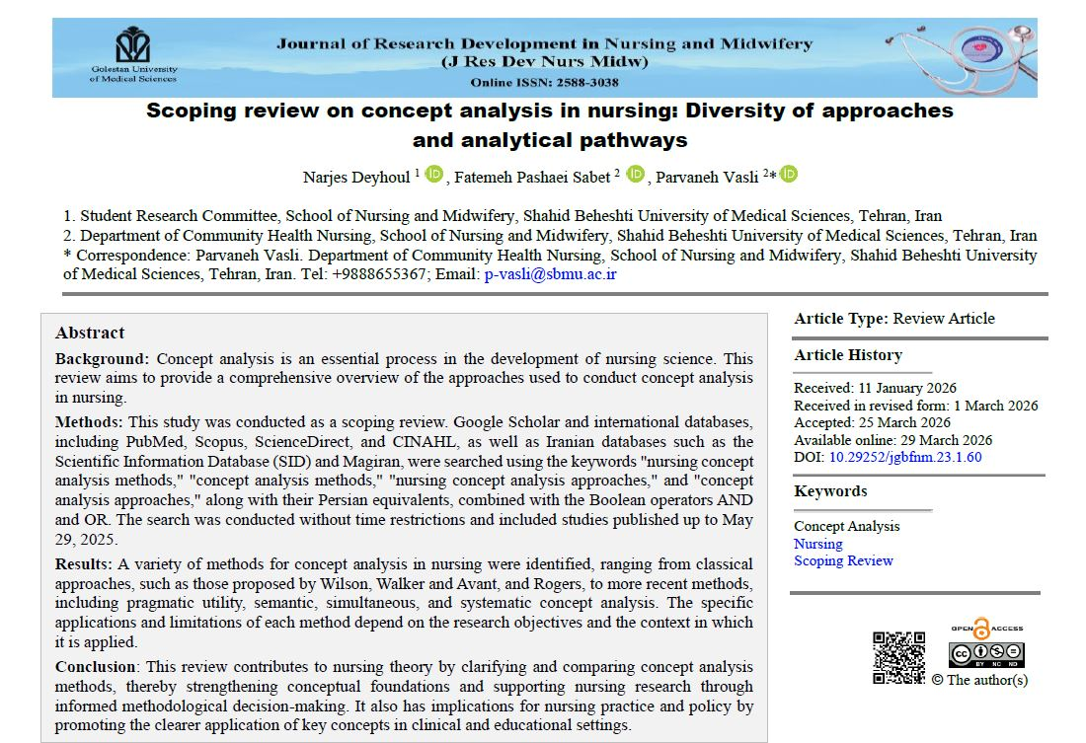


Slide 2
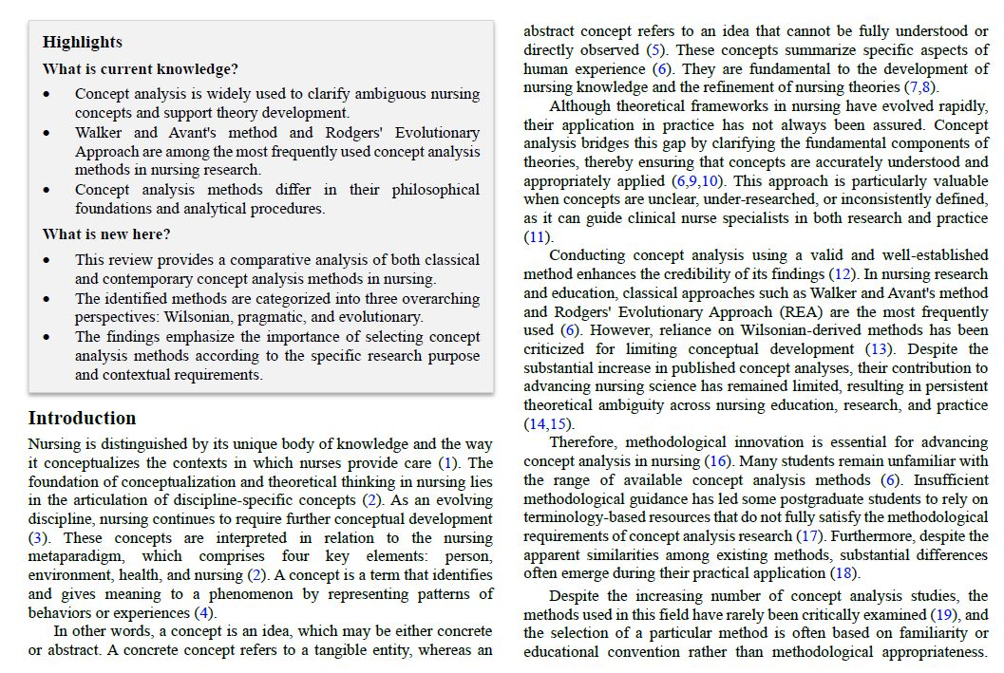
Scoping review on concept analysis in nursing: Diversity of approaches and analytical pathways

Slide 3
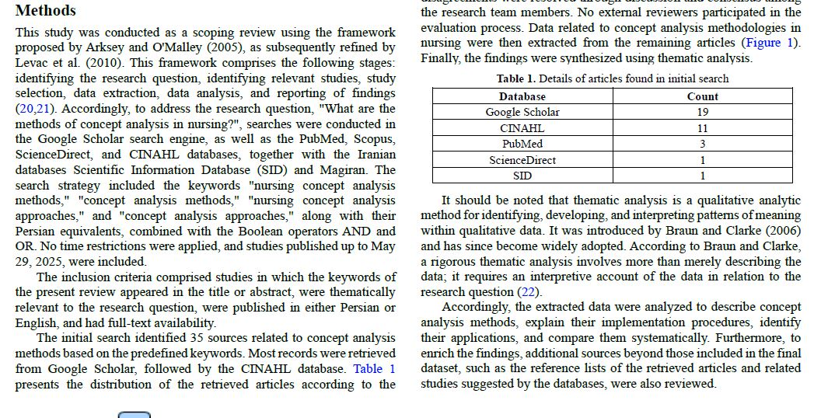
Scoping review on concept analysis in nursing: Diversity of approaches and analytical pathways

Slide 4
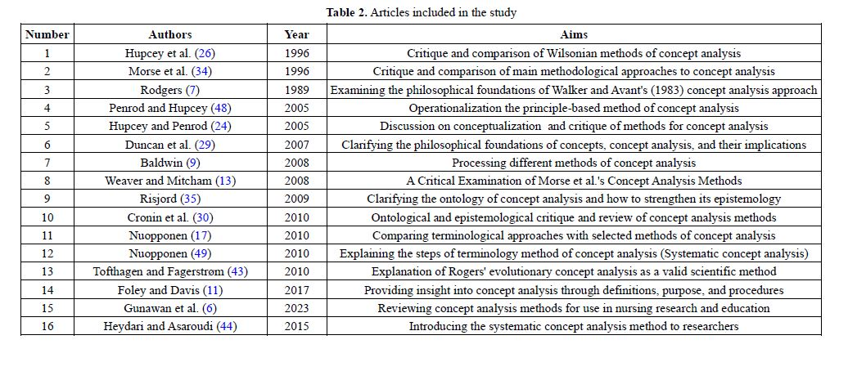
Scoping review on concept analysis in nursing: Diversity of approaches and analytical pathways

Slide 5
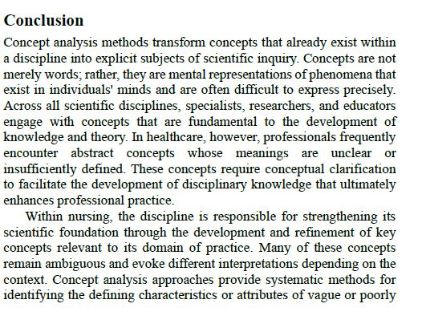
Scoping review on concept analysis in nursing: Diversity of approaches and analytical pathways

